Slide 1


“HDFC-Capstone Project”
Submitted by: Prasad B. Badwar
Submission type : Individual
Name: Prasad Bhausaheb Badwar
Batch : I
LMS Id : prasadbadwar@gmail.com
Program : HDFC-API Developer
Date: 02/05/2023

Slide 2

Table of contents
Introduction
Project Overview
Architecture Design
Back-end Development
Testing
Deployment
Conclusion
References
Appendices

Slide 3
Introduction
A capstone project is a culmination of the knowledge and skills gained throughout an HDFC API Developer program and apply this learning to a real-world project.
The project enables secure and efficient access to employee data, which is crucial for business and organizations to manage their operation in effective manner.
In this project, I have focused on developing a software solution that utilizes a single "getmapping" method to extract data from a database with some encryption format and client can access encrypted data from server and display in decrypted format.
Throughout this project, I have utilized various Java Spring Boot libraries and frameworks, including Spring Data JPA, Lombok, Spring Validation, and PostgreSQL , to develop an efficient and user-friendly software solution. I have also implemented various data securing algorithms, like SSL validation, AES algorithm to extract meaningful insights from employee data.
Also integrate project with GitHub, Jenkin, Docker and Kubernetes.

Slide 4





Project Overview
Features:
SSL Configured
Data Encryption and Decryption-AES256
Log File
CI/CD Pipeline
Tools & Technology:
Language : Java
Framework: Spring Boot Rest API, Spring Data JPA
Database: PostgreSQL 14.7
Software : Eclipse, GitHub, Jenkin, Docker, MiniKube.

Slide 5
Architecture Design
DTO Layer
Postman/
Swagger
Controller
Service
Repository
Database
Entity Layer
Fig. Architecture Design Diagram

Slide 6
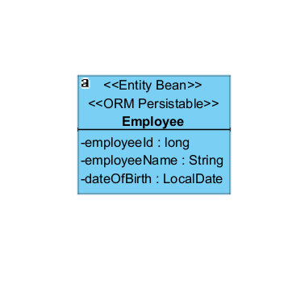
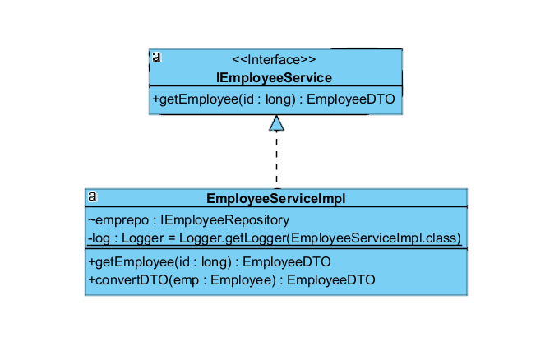
Architecture Design
Entity Class Diagram
Service Class Diagram

Slide 7

Architecture Design
client
Server
Database
HTTP Request
Query for Employee data
Fetching Employee data
HTTPS Response
Fig. Client flow Diagram

Slide 8
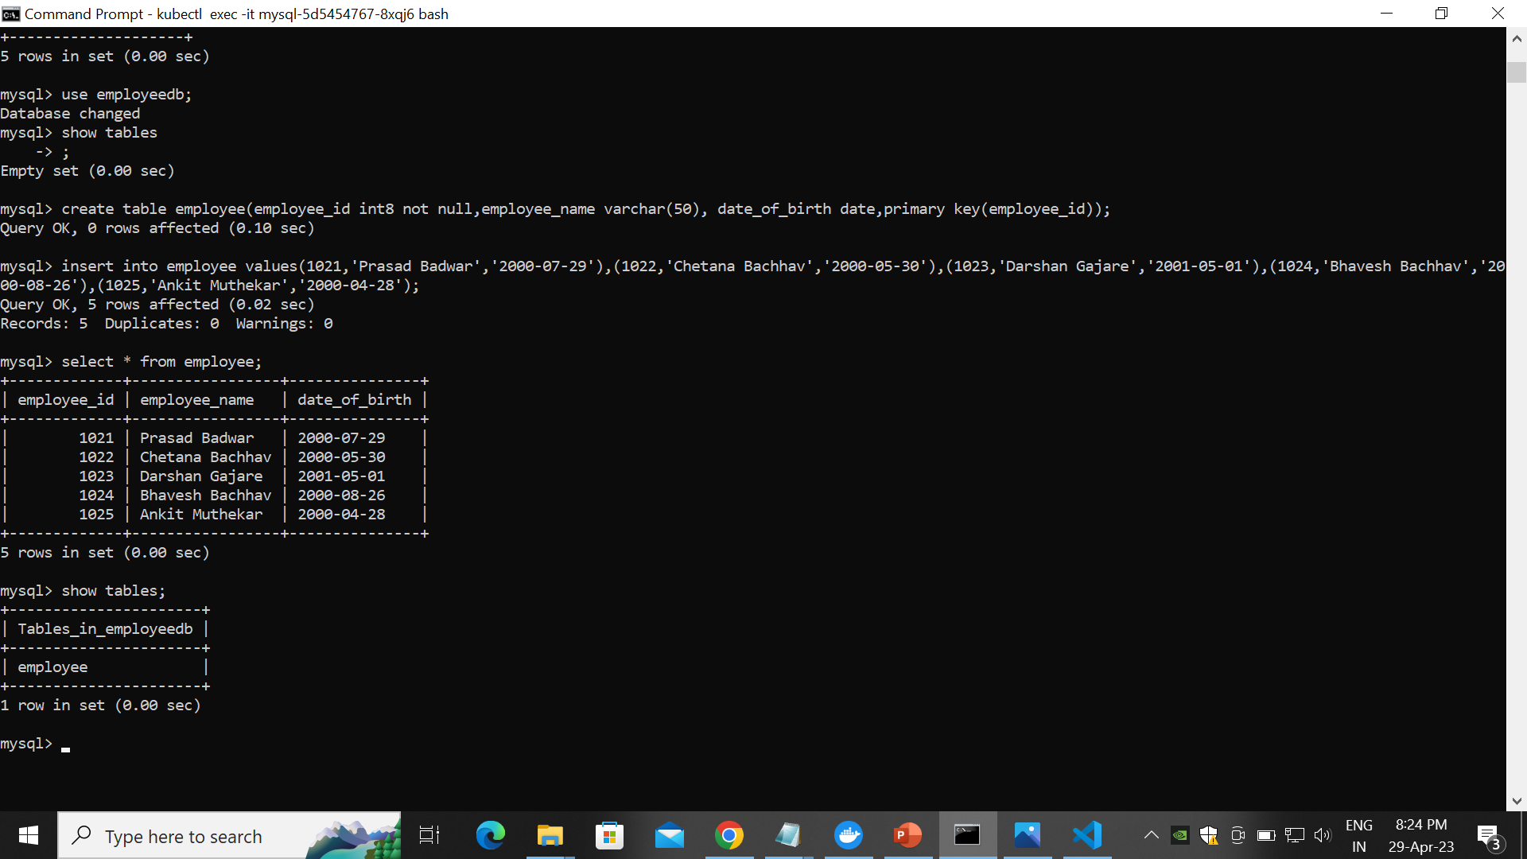
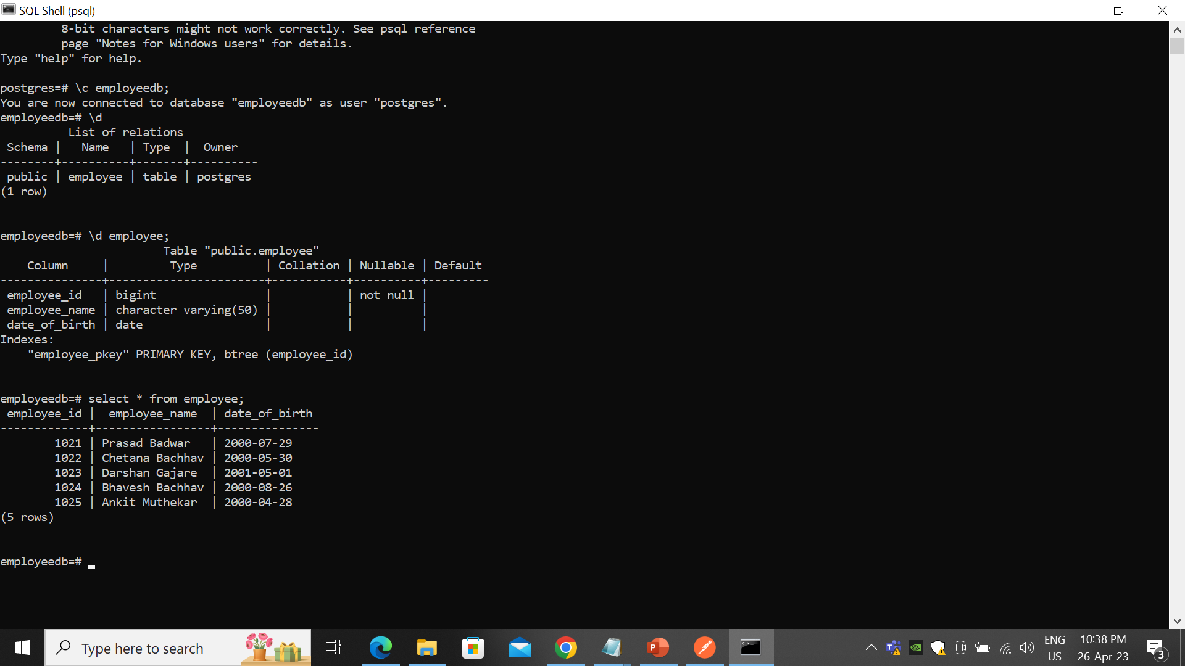
Back-end Development

Slide 9
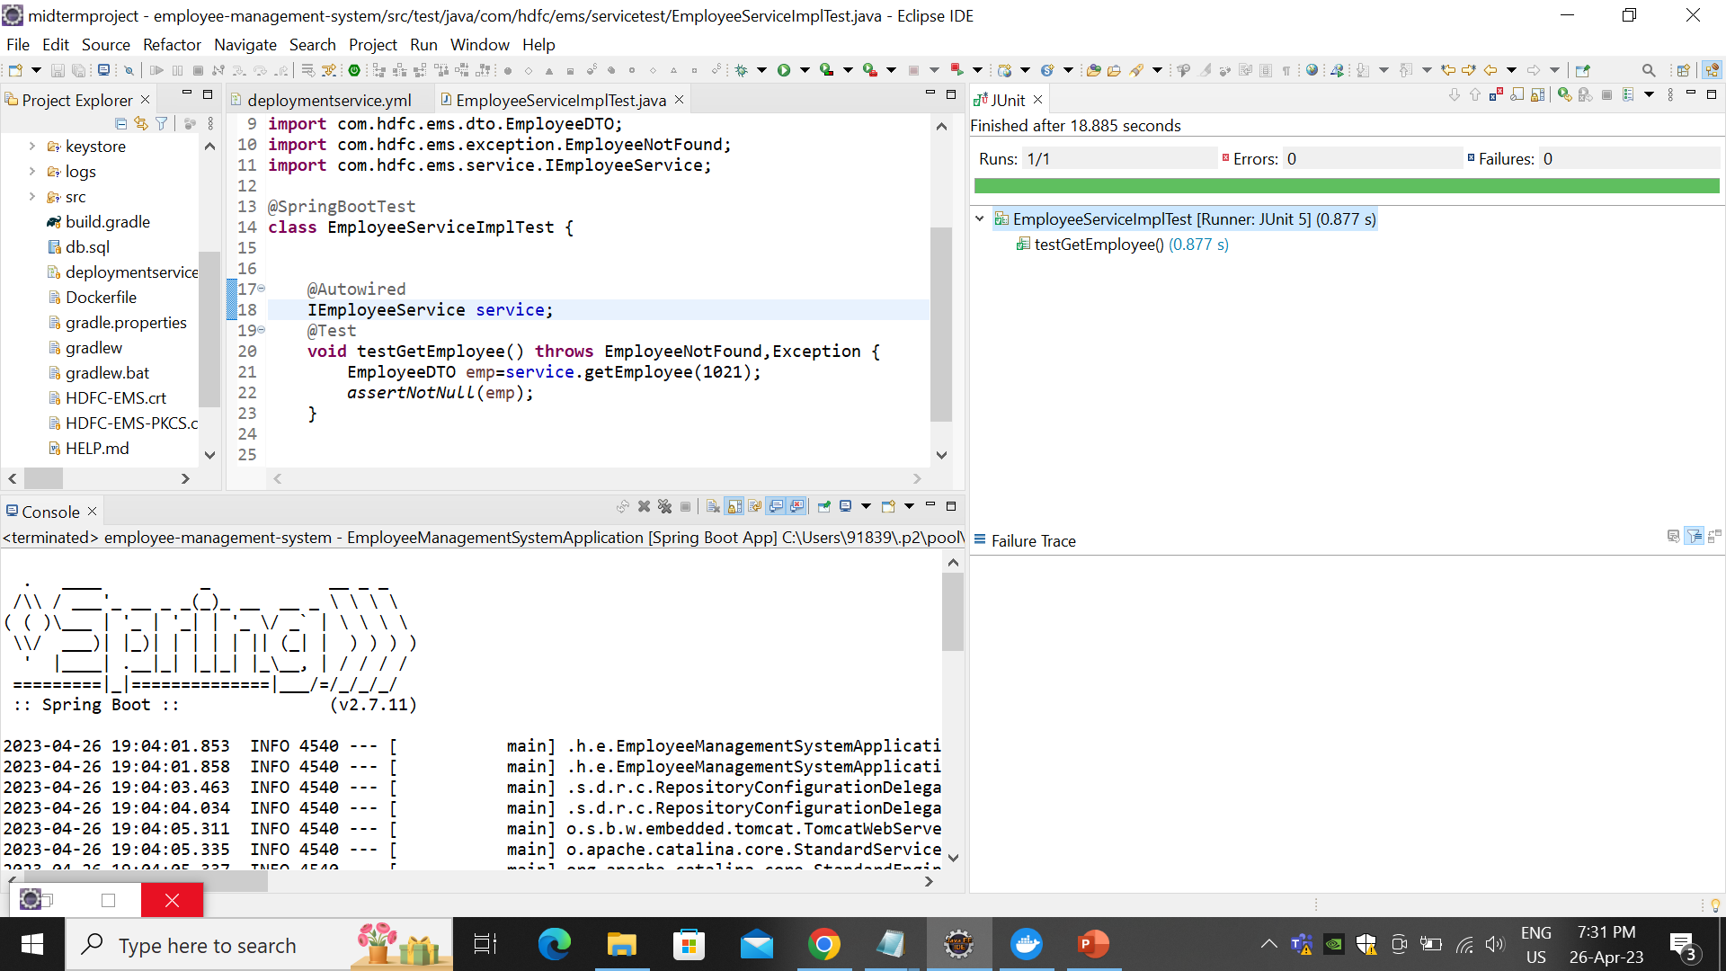
Integration and Testing
1. Junit Testing

Slide 10
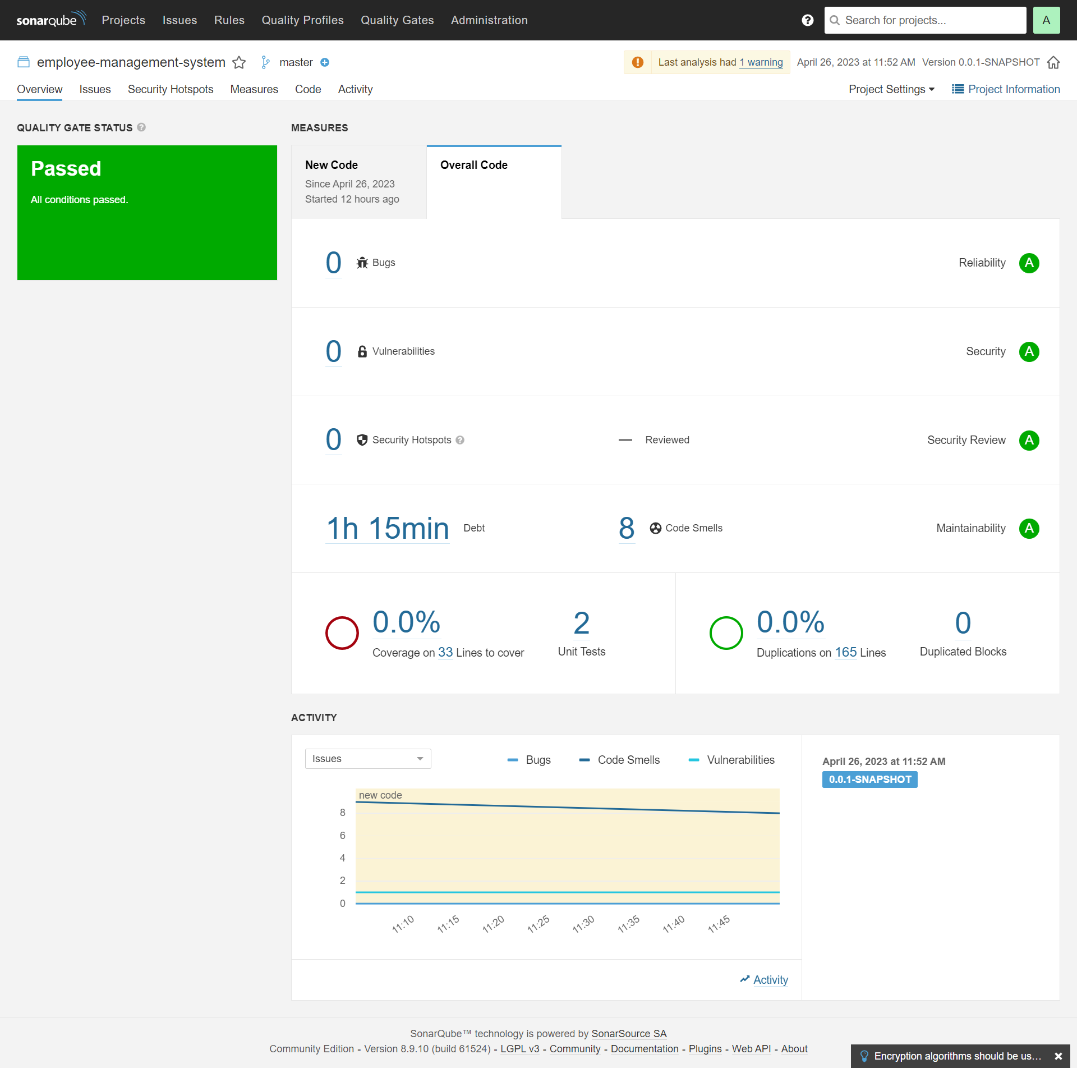
2. SonarQube Testing:

Slide 11
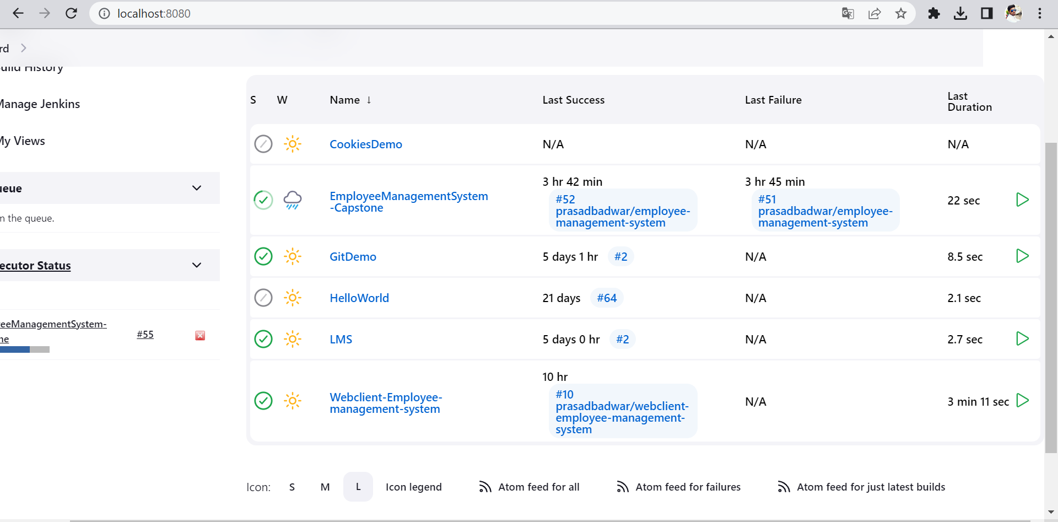
3. Integration with Jenkins:

Slide 12





Deployment
Integrate GitHub with Jenkin
Creating image and
push to Docker hub
Upload Project to GitHub
Deploy image on Kubernetes

Slide 13
Conclusion
In conclusion, my capstone project on Spring Boot using Java has been a great learning experience for me. I was able to explore the features and benefits of the Spring Boot framework and see how it simplifies the process of building robust and scalable applications. Through our project, we gained valuable knowledge on how to use Spring Boot to build a fully functional web application.
Overall, this capstone project showcases my proficiency in Java Spring Boot programming, data processing. I believe that Spring Boot is a highly useful framework for building Java-based web applications, and my project has provided us with a solid foundation to continue exploring its features and capabilities. I highly recommend Spring Boot to any developers looking to build scalable, robust, and easy-to-maintain web applications.

Slide 14
References
11 Weeks of Training under Trainer Mr. Javeed Sir - Manipal Global Academy
SSL Certificate validation https://www.thomasvitale.com/https-spring-boot-ssl-certificate/
AES-256 encryption in java https://www.javatpoint.com/aes-256-encryption-in-java
Log File https://howtodoinjava.com/spring-boot2/logging/spring-boot2-log4j2-properties/
Jenkin-Kubernetes Integration
https://sweetcode.io/how-to-deploy-an-application-to-kubernetes-cluster-using-jenkins-ci-cd-pipeline/

Slide 15
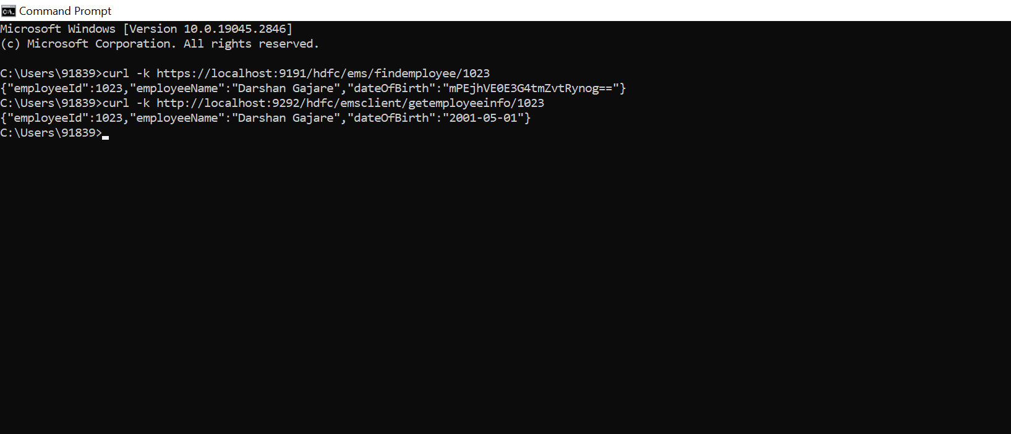
Appendices

Slide 16
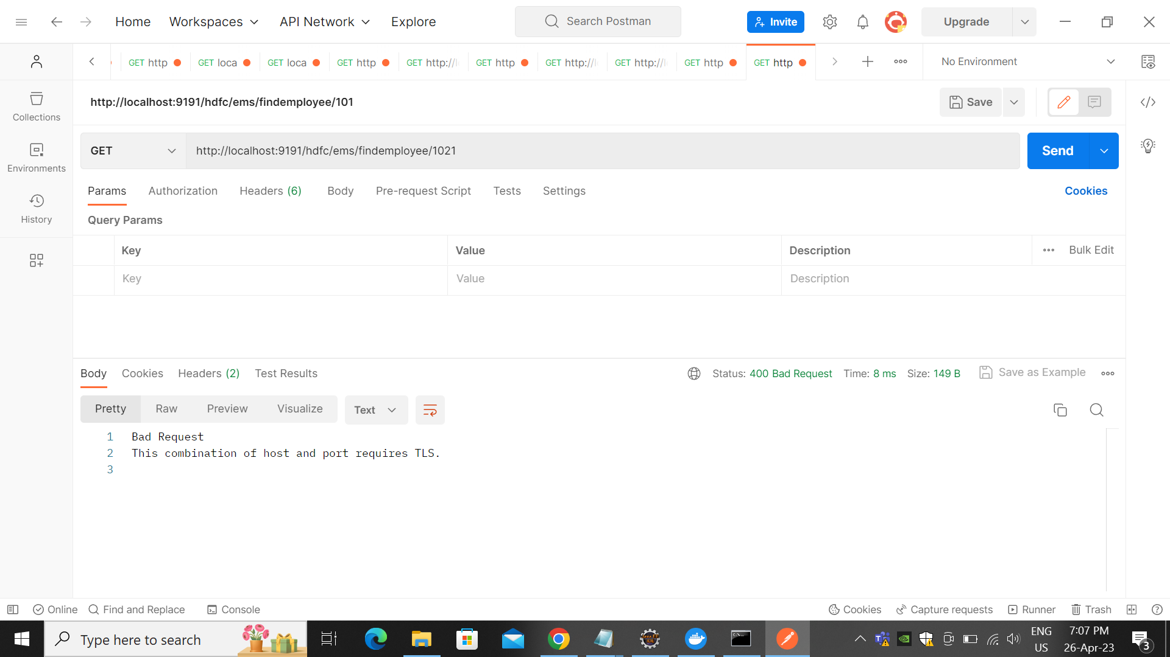

Slide 17
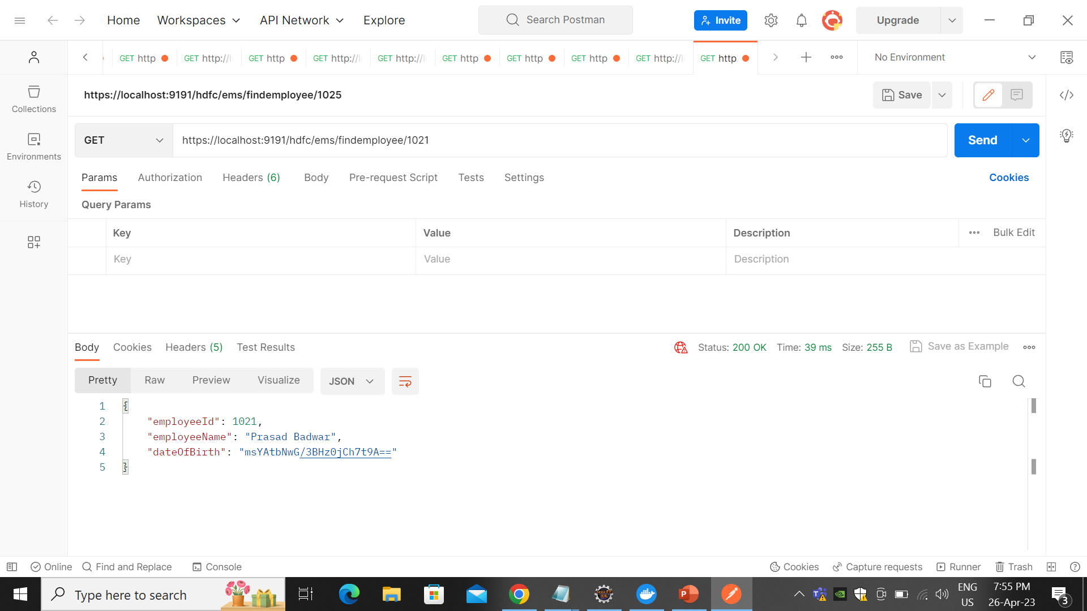

Slide 18
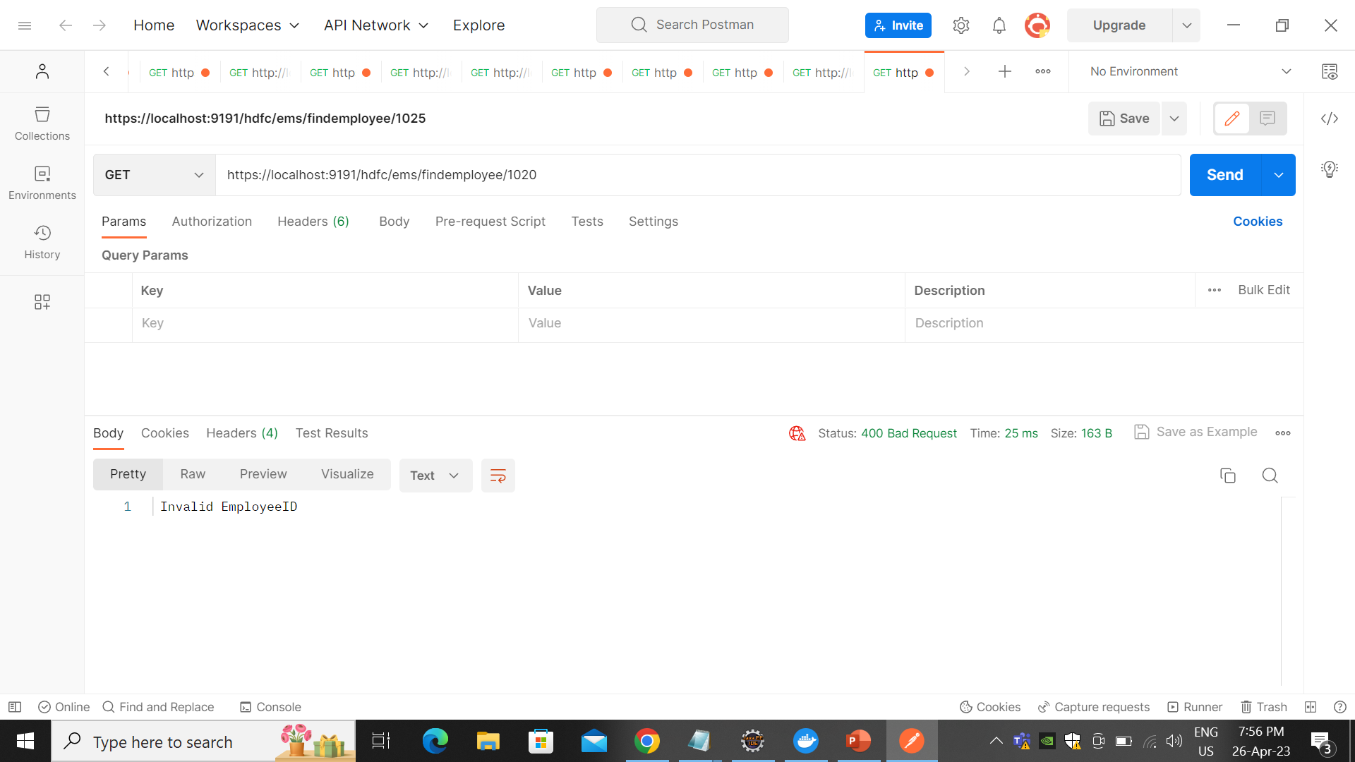

Slide 19


Slide 20
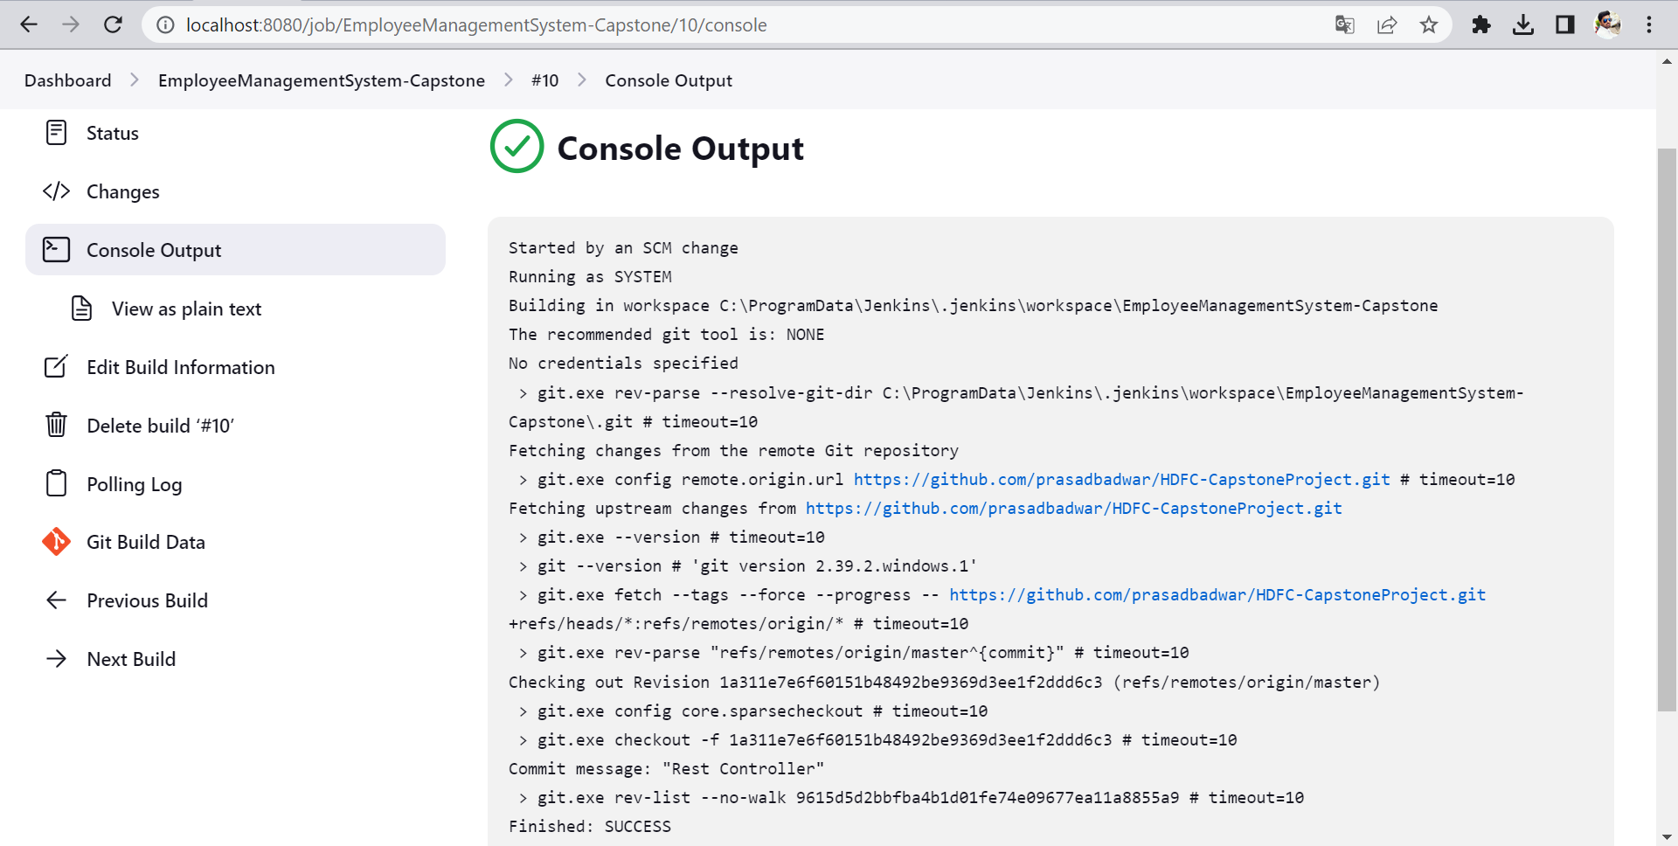
Integrate Github with Jenkin

Slide 21
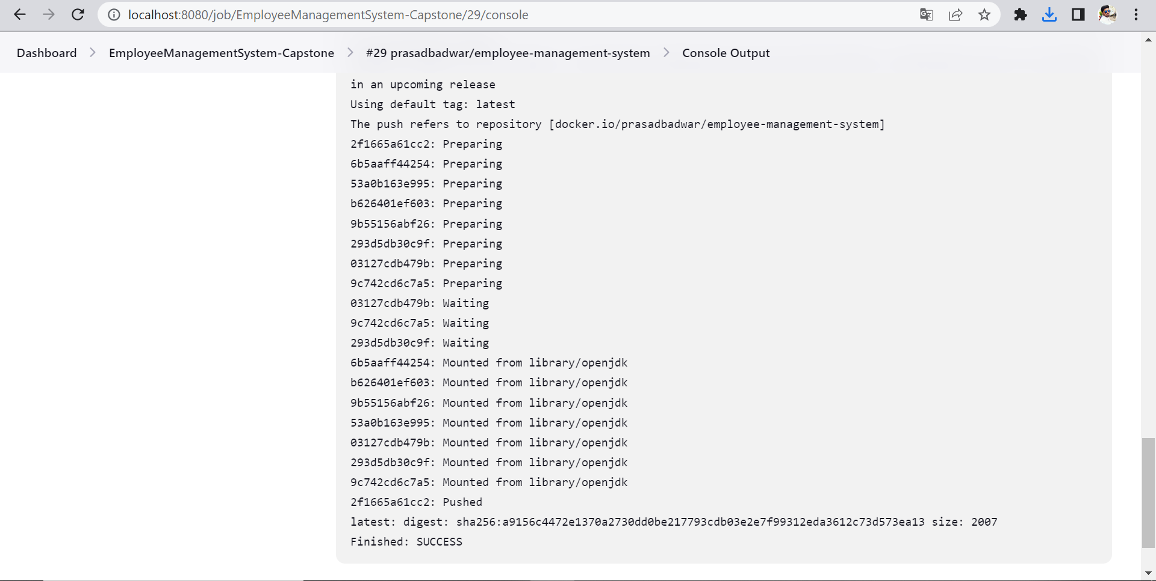
Pushed Image to Docker Hub

Slide 22
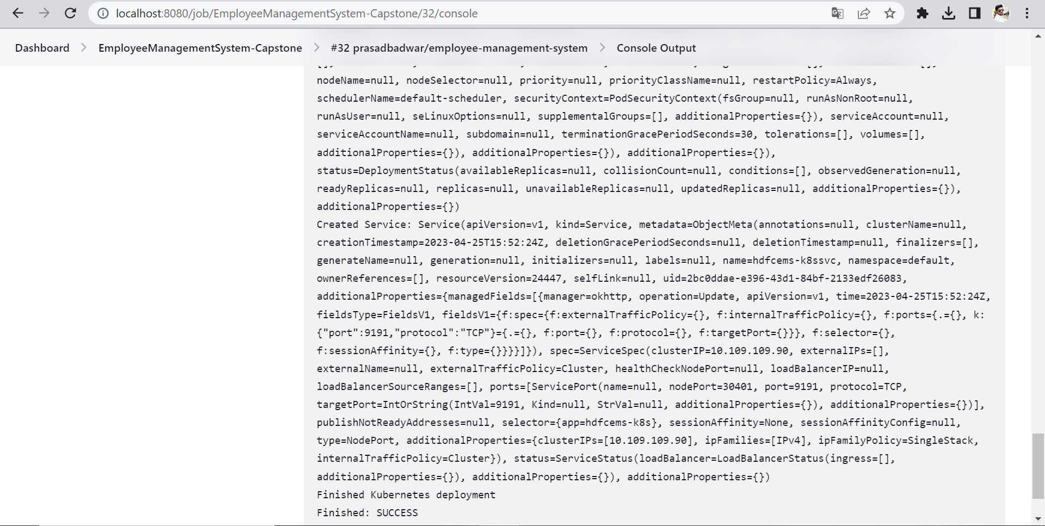
Deploy Docker Image on Kubernetes

Slide 23
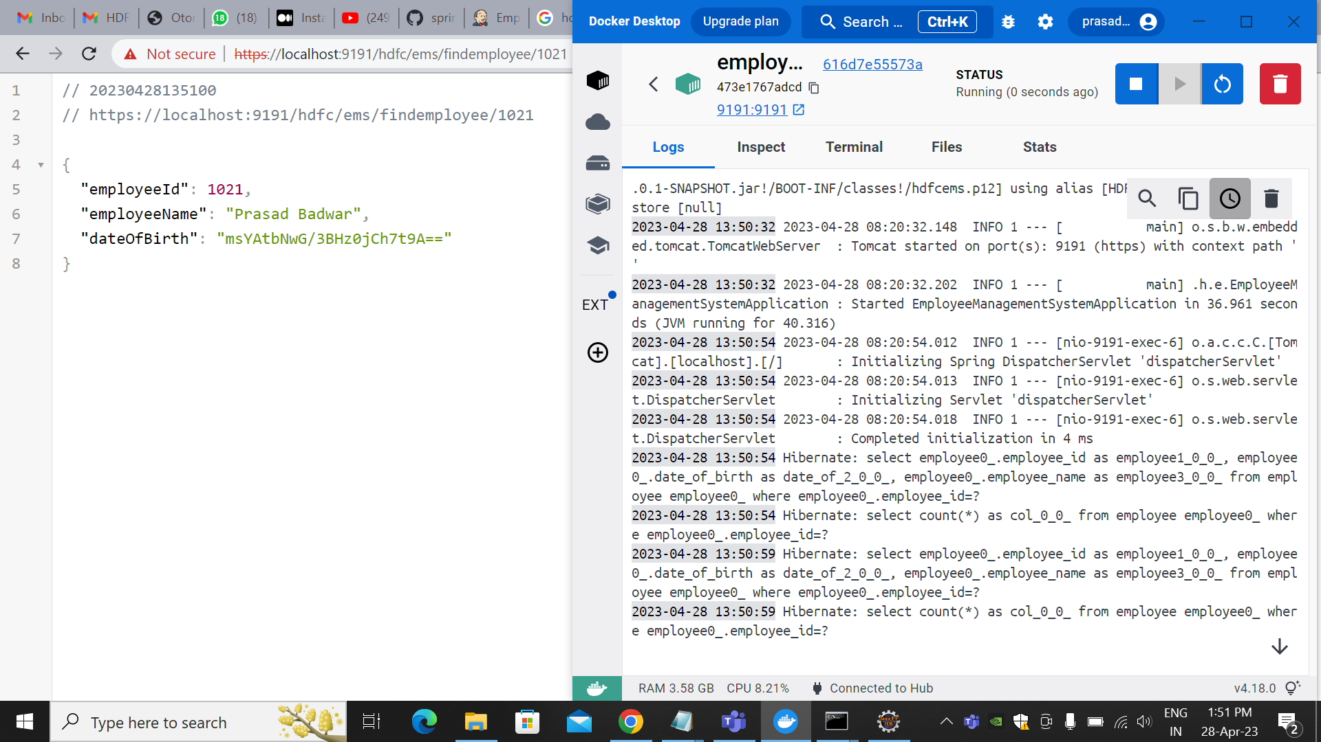

Slide 24
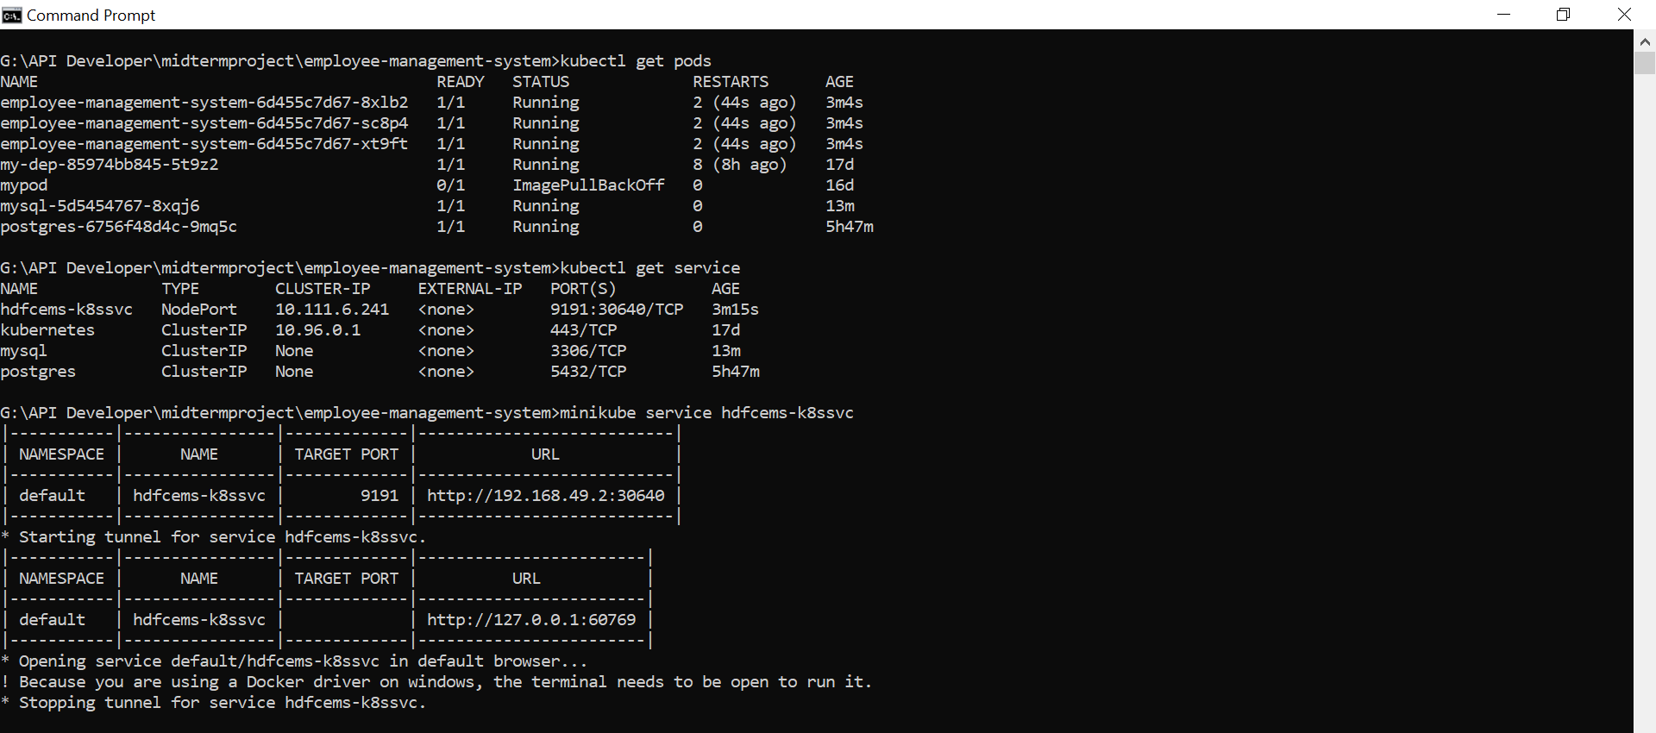
Deploy Image on Kubernetes

Slide 25
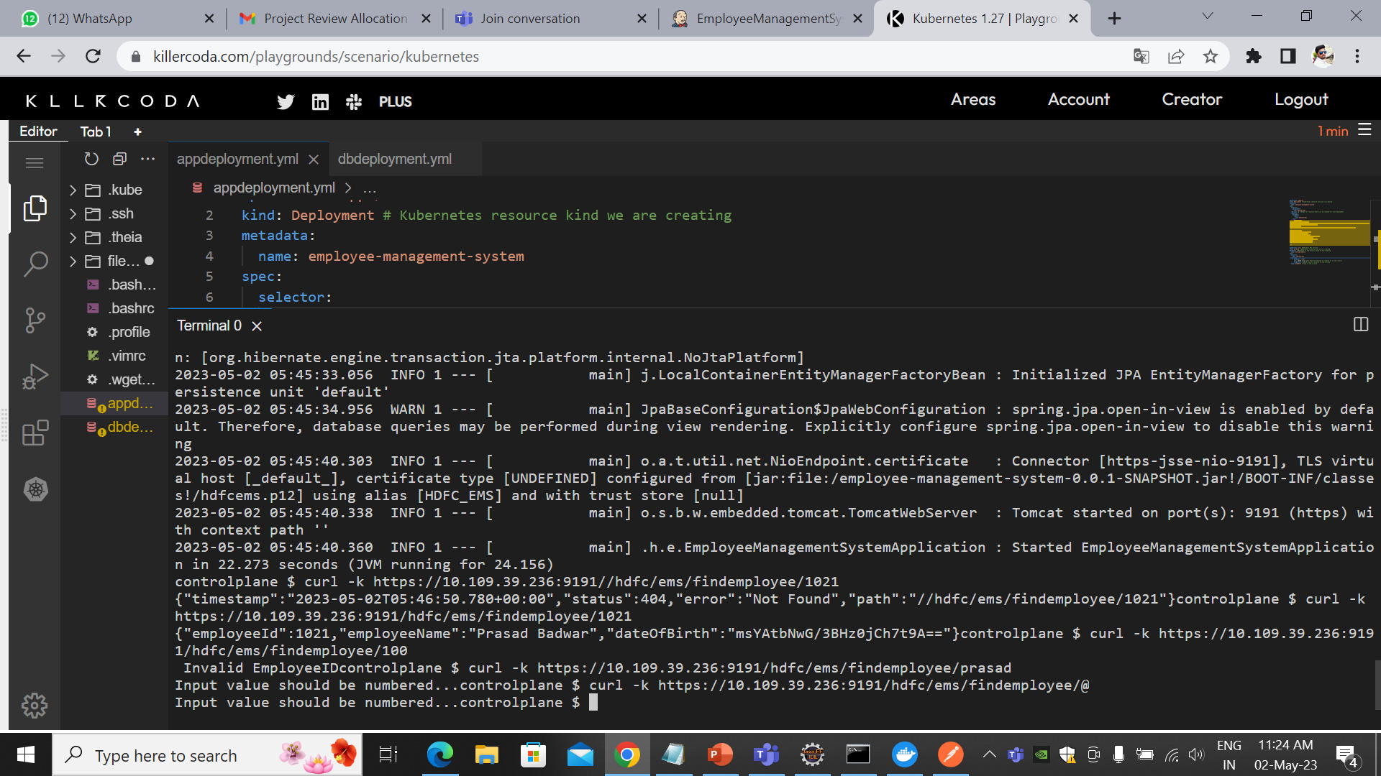
Running Project on Kubernetes

Slide 26
Thank You

